Slide 1
Adjustments To Income
Pub 17 Chapter 17-19
Pub 4012 Tab E
(Federal 1040-Lines 23-37)
Notes:
1

Slide 2
Definitions
Adjustments: dollar-for-dollar subtractions from income
Total Income
less Adjustments
Adjusted Gross Income (AGI)
Notes:
2

Slide 3
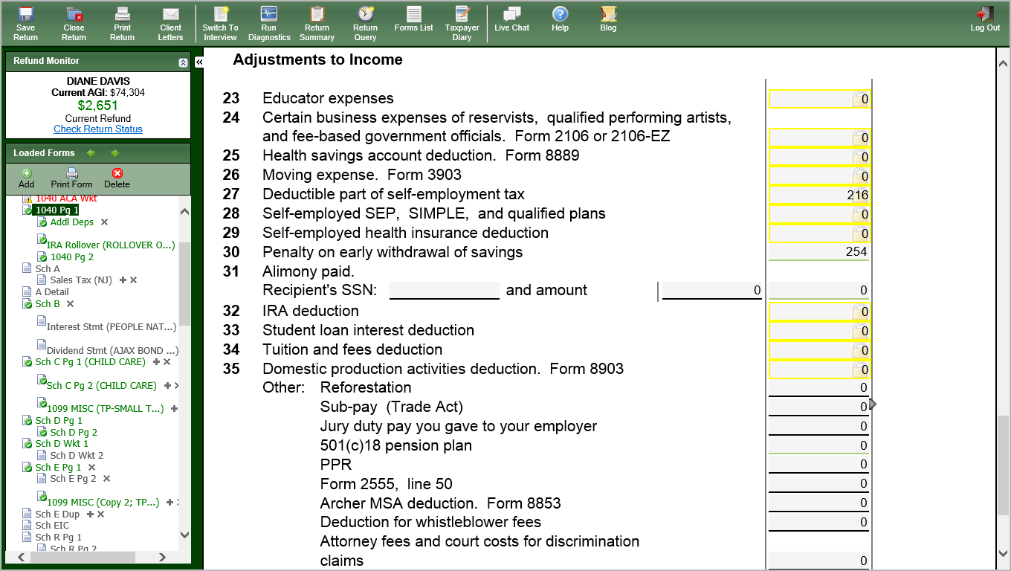
TW-Adjustments to Income
Notes:
This is the Adjustments to Income section of the 1040
3

Slide 4
Adjustments To Income In Scope
Educator expenses
Health savings account (HSA)(special certification)
Deductible part of self-employment tax
Penalty on early withdrawal of savings
Alimony paid
IRA deduction
Student loan interest deduction
Tuition & fees
Return of jury duty pay to employer
Notes:
4

Slide 5
Adjustments To Income Out of Scope
Certain business expenses (1040 Line 24)
Moving expenses (1040 Line 26)
Self-employed SEP, SIMPLE & qualified plans (1040 Line 28)
Self-employed health insurance (1040 Line 29)
Domestic production activities and other miscellaneous deductions (1040 Line 35)
Notes:
Example of Domestic Production activities include gas/oil
5

Slide 6
Educator Expenses
Pub 4012 Page E-3
Teachers/Instructors grades K - 12
Unreimbursed classroom expenses
Must work 900 hours in school year
Maximum adjustment $250
If expenses > $250, enter excess on Sch A Line 21 Unreimbursed Employee Expenses
Use 1040 Wkt 2 (link from 1040 Line 23) to enter
Notes:
6

Slide 7
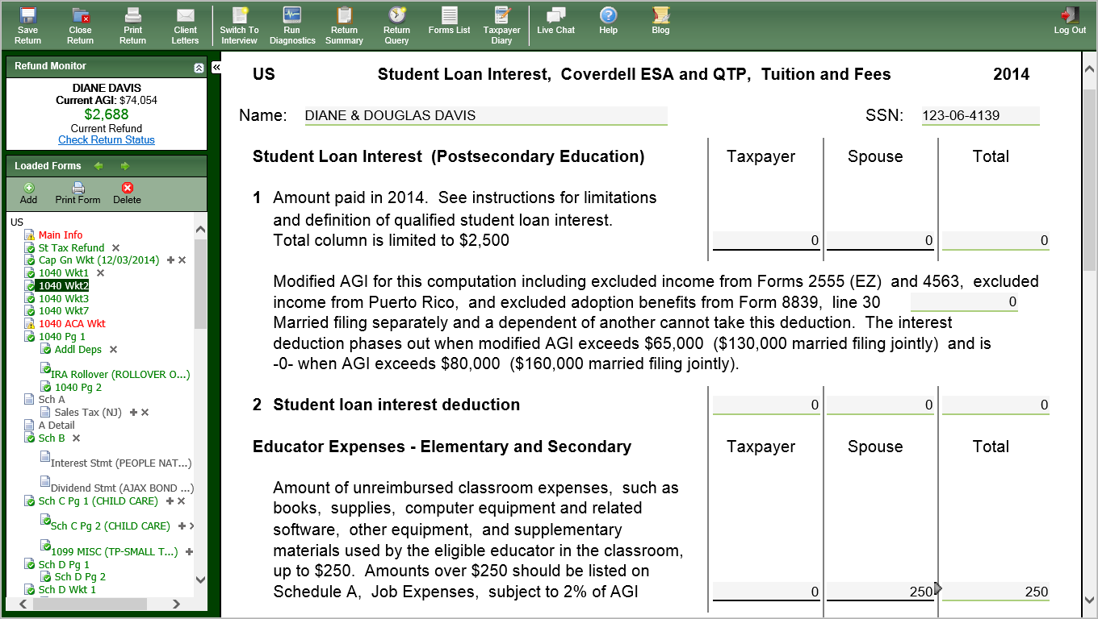
TW-Educator Expenses
Notes:
Enter amount of unreimbursed educator expenses (up to $250) under section “Educator Expenses – Elementary and Secondary”
7

Slide 8
Deductible Part of Self-Employment Tax
Applies to self-employed who reported income on Schedule C
TaxWise automatically calculates SS & Medicare Tax that must be paid by taxpayer on Schedule SE
½ of tax from Schedule SE automatically goes to Form 1040 Line 27 in TaxWise as an income adjustment
Notes:
8
Tax law allows self-employed to get an adjustment to income for ½ of self-employment tax they must pay for Medicare & Social Security. This is equivalent to the amount that employers pay on behalf of employees

Slide 9
Penalty on Early Withdrawal of Savings
Early Withdrawal Penalty occurs when funds are withdrawn from CDs before maturity
Reported in Box 2 of 1099-INT or
Box 3 of 1099-OID
In TaxWise, penalty automatically carries to 1040 Line 30 from 1099-INT or 1099 OID entry
Notes:
9

Slide 10
Alimony Paid
Pub 4012 Tab E
Divorce/Separation agreement required
Enter as Adjustment to Income
Reported on Federal 1040 Line 31
Must also provide recipient’s SS #
Recipient must report as income
Reported on Federal 1040 Line 11 Alimony Received
Notes:
10

Slide 11
IRA Contribution Deduction
Only traditional IRA - not Roth, Simple, etc.
Criteria:
Taxpayer must have earned income
Wages, Self-Employment income, etc.
Under 70 ½
Max amount of contribution is lesser of compensation or $5,500 ($6,500 if age 50 or over)
If taxpayer and/or spouse have employer retirement plan, deductible amount of contribution is based on filing status & AGI (Tables)
Can make tax year contribution until 4/15 of following year
Notes:
11

Slide 12
IRA Contribution Deduction
(cont’d)
Use IRA Wkt to enter IRA contributions
Non-deductible (after-tax) contributions tracked on Form 8606 (discussed under IRA section)
See TaxPrep4Free.org Special Topic document “IRA Non- Deductible Contributions and Deductions”
Excess contribution: Amount in excess of limits or contributed after age 70½.
Must withdraw excess before return due or pay 6% penalty
If taxpayer > 70½ , can make contribution to spousal IRA if spouse is under 70½
If taxpayer makes contribution to IRA, may also get Retirement Savings Credit
TW brings up Form 8880 for data entry
Notes:
12

Slide 13
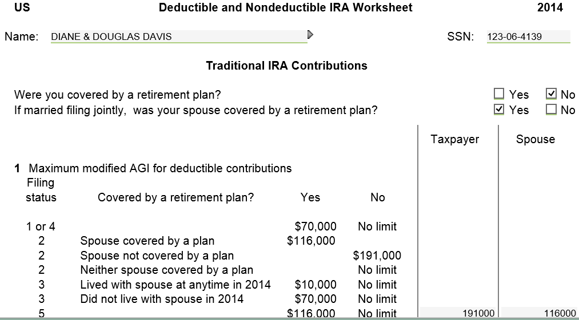
TW-IRA Wkt for IRA Contributions
Notes:
IRA Wkt is used to calculate the deductible & non-deductible portions of client’s IRA contributions
TW calculates most of this Worksheet from income data already entered. Just enter IRA contribution on Line 10
13

Slide 14
TW IRA Wkt
(cont’d)
TW calculates maximum
allowable contribution
Enter current tax year IRA contribution
TW calculates deductible portion
of IRA contributions; transfers to 1040 Line 32
Nondeductible contributions tracked
on Form 8606
Notes:
Line 10 is where you must enter IRA contributions (underlined in red)
TW calculates deductible portion of IRA contributions & transfers to 1040 Line 32
TW transfers Nondeductible Contributions to Form 8606. This keeps a record of amounts that will not be taxed again when IRA distribution is taken
14

Slide 15
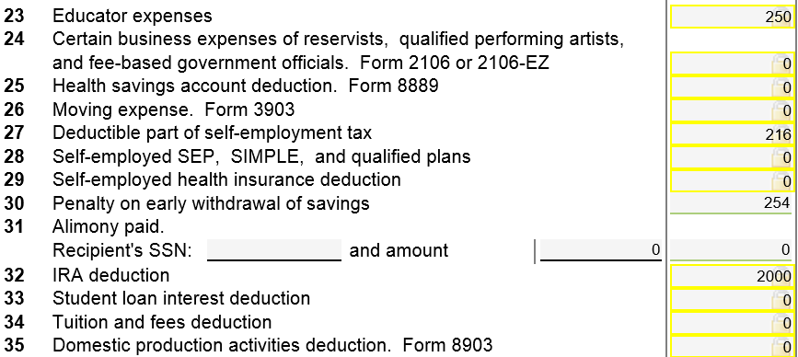
TW 1040 Line 32 – Deductible IRA Contribution
TW transfers from
IRA Wkt Line 11
Notes:
15

Slide 16
Student Loan Interest Deduction
Pub 4012 Tab J
Interest paid on a qualified student loan
Eligible expenses: tuition, room & board, books
Expenses & loan for taxpayer, spouse or depend- ents enrolled at least ½ time in degree program
Cannot be claimed if taxpayer can be claimed as dependent by someone else
Loan cannot be from relative
Maximum benefit is $2,500, depending on AGI, Filing Status (TW computes)
Notes:
16
Income Limitations apply
Student Loan interest deduction not available for MFS
To claim this deduction, you must be legally obligated to pay
i.e. - if loan is in child’s name, only child can take deduction (even if parents pay off loan)

Slide 17
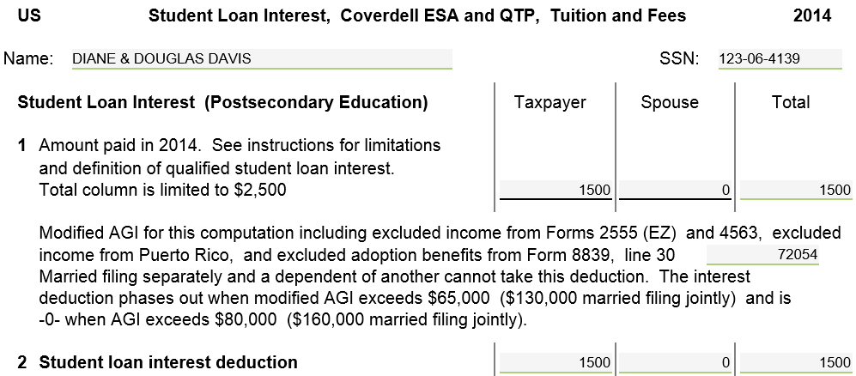
TW-1040 Wkt 2 - Student Loan Interest
Notes:
Enter Student Loan Interest on 1040 Wkt 2 in section “Student Loan Interest (Postsecondary Education)”
TW transfers Student Loan Interest deduction to 1040 Line 33
17

Slide 18
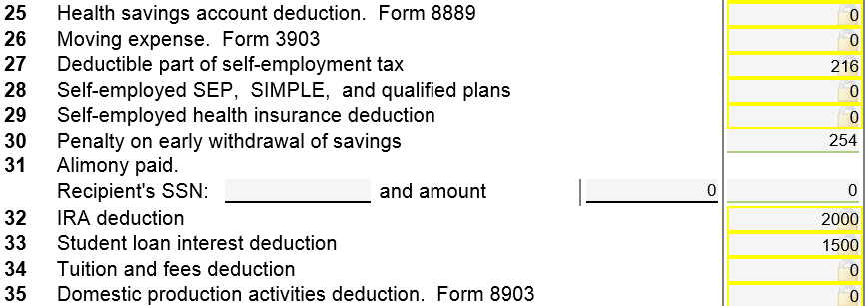
TW 1040 Line 33 – Student Loan Interest
TW transfers from 1040 Wkt 2
Notes:
TW transfers Student Loan Interest deduction from 1040 Wkt 2 to 1040 Line 33
18

Slide 19
Tuition & Fees Deduction - Reported on Form 1098-T (covered in Education Expenses module)
Tuition
Fees, books, supplies, equipment only qualified if must be paid to institution as a condition of enrollment
Covers taxpayer, spouse or dependent
Maximum deduction $4,000, depending on AGI/Filing Status
Enter on 1040 Wkt 2
Cannot also take Education Credit(s) for same expenses, so compare
Unless TP has high income, education credit is more beneficial than Tuition & Fees deduction
NOTE: Data on Form 1098-T does not necessarily provide full out-of-pocket tuition paid by taxpayer. Ask what they paid.
Notes:
Always wait until the end of the return (after Diagnostics) to input education expenses to compare Education Credits vs Tuition & Fees deduction
19

Slide 20
Return of Jury Duty Pay to Employer
Some companies pay employees normal pay while on jury duty & then require reimburse- ment of actual jury duty pay to company
In this situation:
Employees’ normal pay during jury duty included in Wages on 1040 Line 7
Actual jury duty pay included as 1040 Line 21 Other Income
If you returned jury duty pay to your employer, enter amount on 1040 Line 35 as Adjustment to Income
Notes:
20

Slide 21
Summary - Entering Adjustments into TW
Entries can be made on these Federal 1040 Lines only; all others are Out Of Scope
Educator expenses
Enter on 1040 Wkt 2
Deductible part of self-employment tax (Line 27)
Automatically calculated from Schedule SE
Penalty on early withdrawal of savings (Line 30)
Flows from Interest Stmt
Alimony paid (Line 31)
Notes:
21

Slide 22
Summary - Entering Adjustments into TW
(cont’d)
IRA deduction (Line 32)
Enter on IRA Wkt
Student loan interest deduction (Line 33)
Enter on 1040 Wkt 2
Tuition & fees deduction (Line 34)
Enter on 1040 Wt 2
Jury duty pay returned to your employer
Actual jury duty pay included as 1040 Line 21 Other Income
Enter amount returned to employer on 1040 Line 35
Notes:
22

